Slide 1
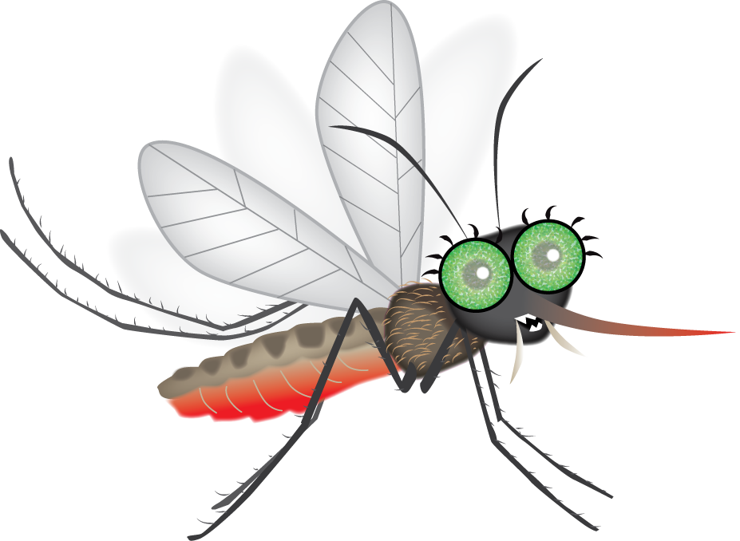
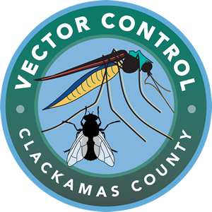
Staying OUT of Mosquito Food Webs
BEWARE OF MOSQUITULA!
Notes:
Start the slide show using the buttons at the top or bottom of the screen. Discuss the content in these notes and on the lesson plan with students.

Slide 2
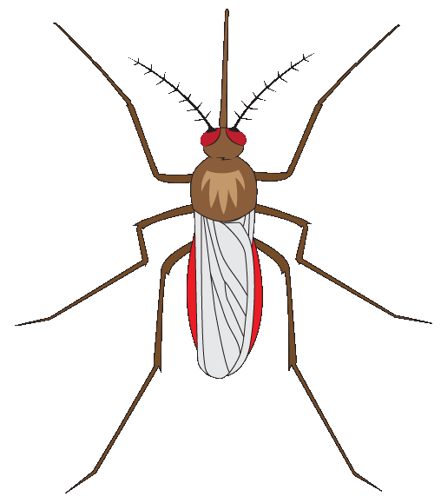
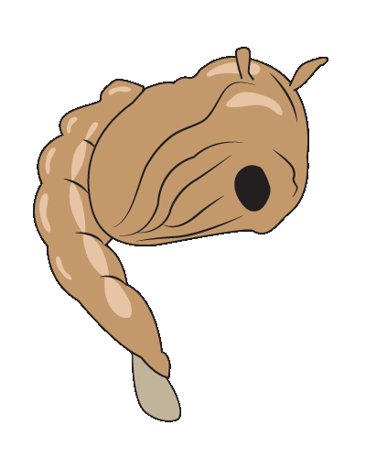
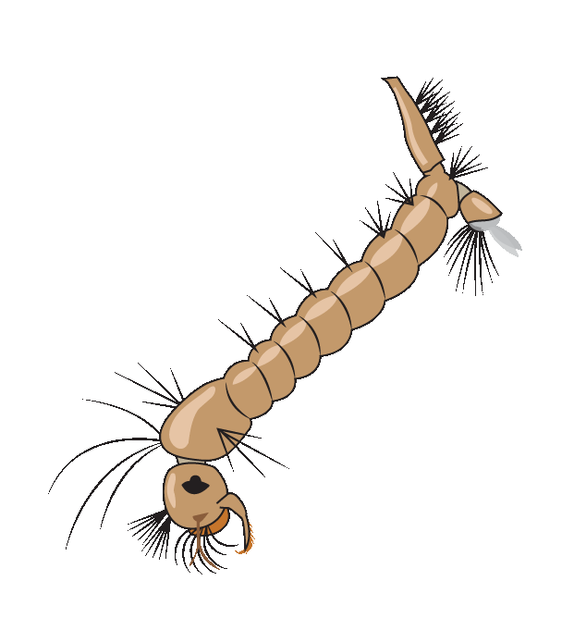
Warmth
Adult
Nectar
Blood
Pupa
Egg Raft
Larva
Notes:
Review the previous lesson about the mosquito life cycle by asking students about each stage in a mosquito’s life—egg, larva, pupa, and adult—before you reveal the stages on screen. Ask students questions to get them thinking, such as, “How does a mosquito begin it’s life?” and “What does a mosquito larva need to live?”

Slide 3
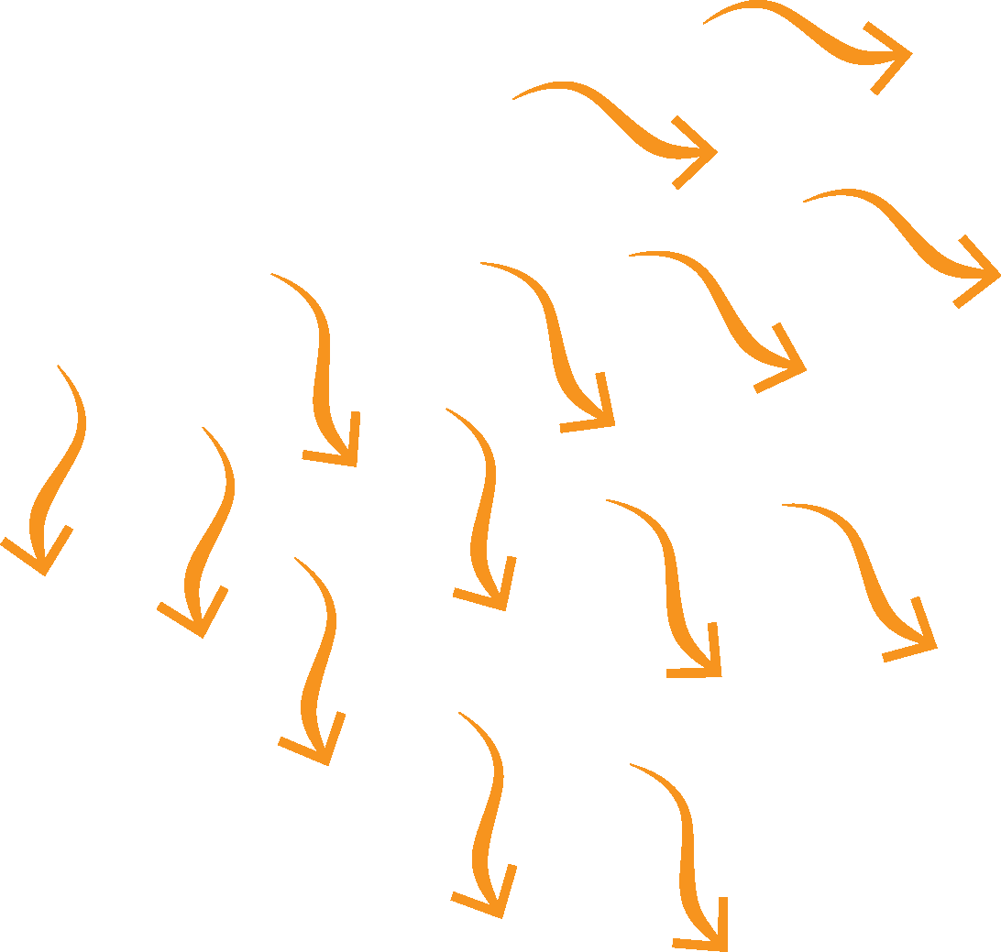
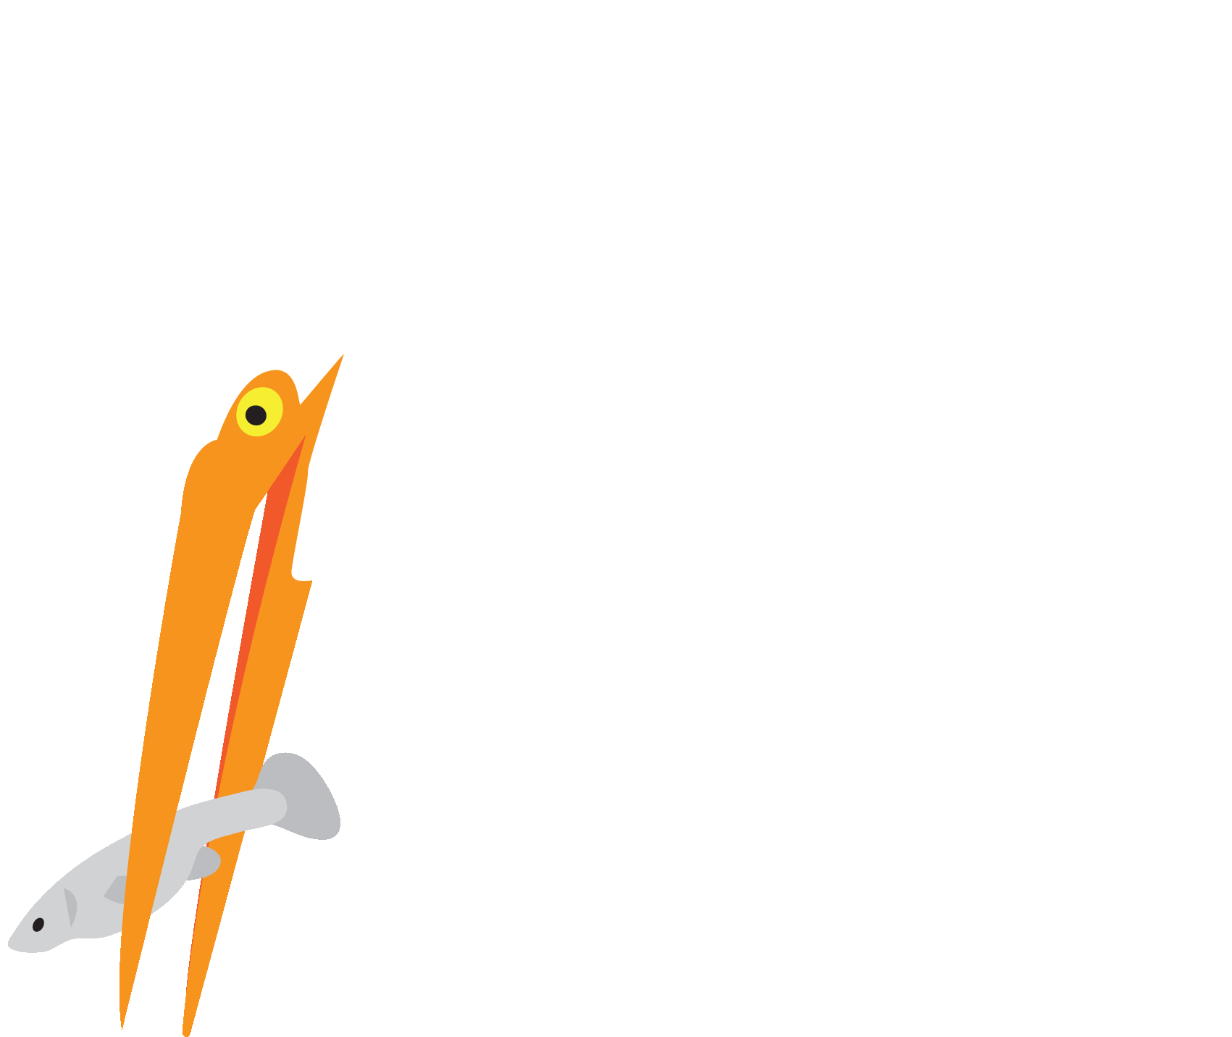
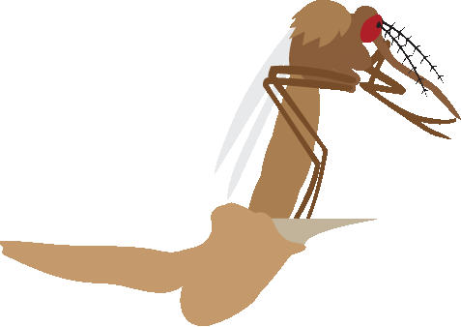
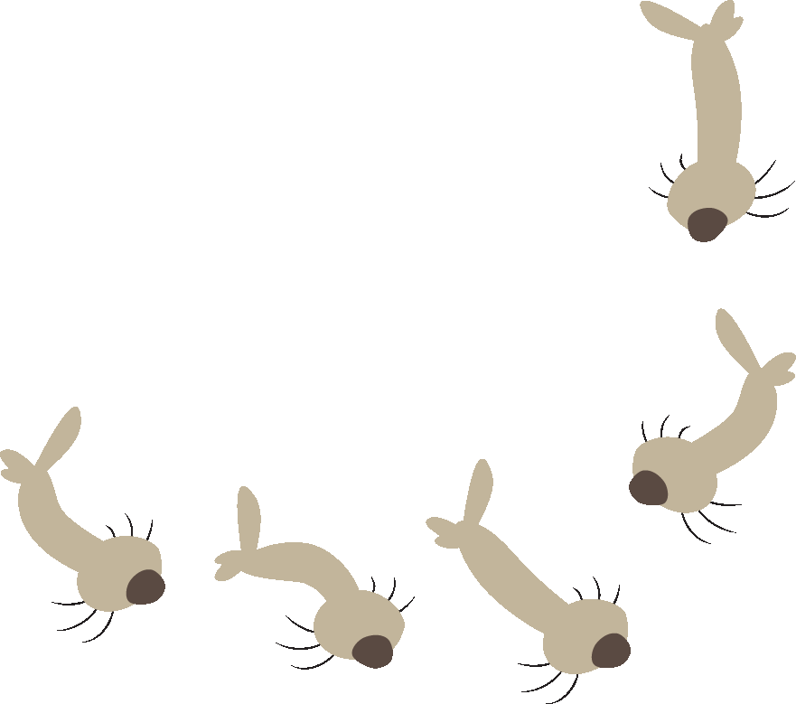
Wetland Ecosystem
Producers
Consumers
Notes:
Ask the class why the Sun is so important for life on Earth. Discuss how it provides the energy which plants (producers) use to make food, and that the plants then become food for animals (consumers) like mosquito larvae. Mosquito fish are predators which can eat the larvae and other animals, and birds like egrets can eat the fish, continuing the food chain. Dragonflies are one animal that can eat adult mosquitoes. Discuss how all the living and nonliving things are interconnected in an ecosystem—in this case a wetland ecosystem which is known for having a lot of biodiversity (different types of living things). Explain that organisms (living things) in an ecosystem actually interact in a food web, because they both eat and are eaten by other organisms.
Optional: Call on volunteers to act out a food chain for the rest of the class. Start with a volunteer to play the Sun, holding up their arms in a big circle above their head. Then ask for a volunteer to play an organism which can make food from the Sun, followed by mosquito larvae which can eat the producers, fish that can eat them, etc. Ask the students to try to make themselves look and/or act like the organisms they are playing.

Slide 4
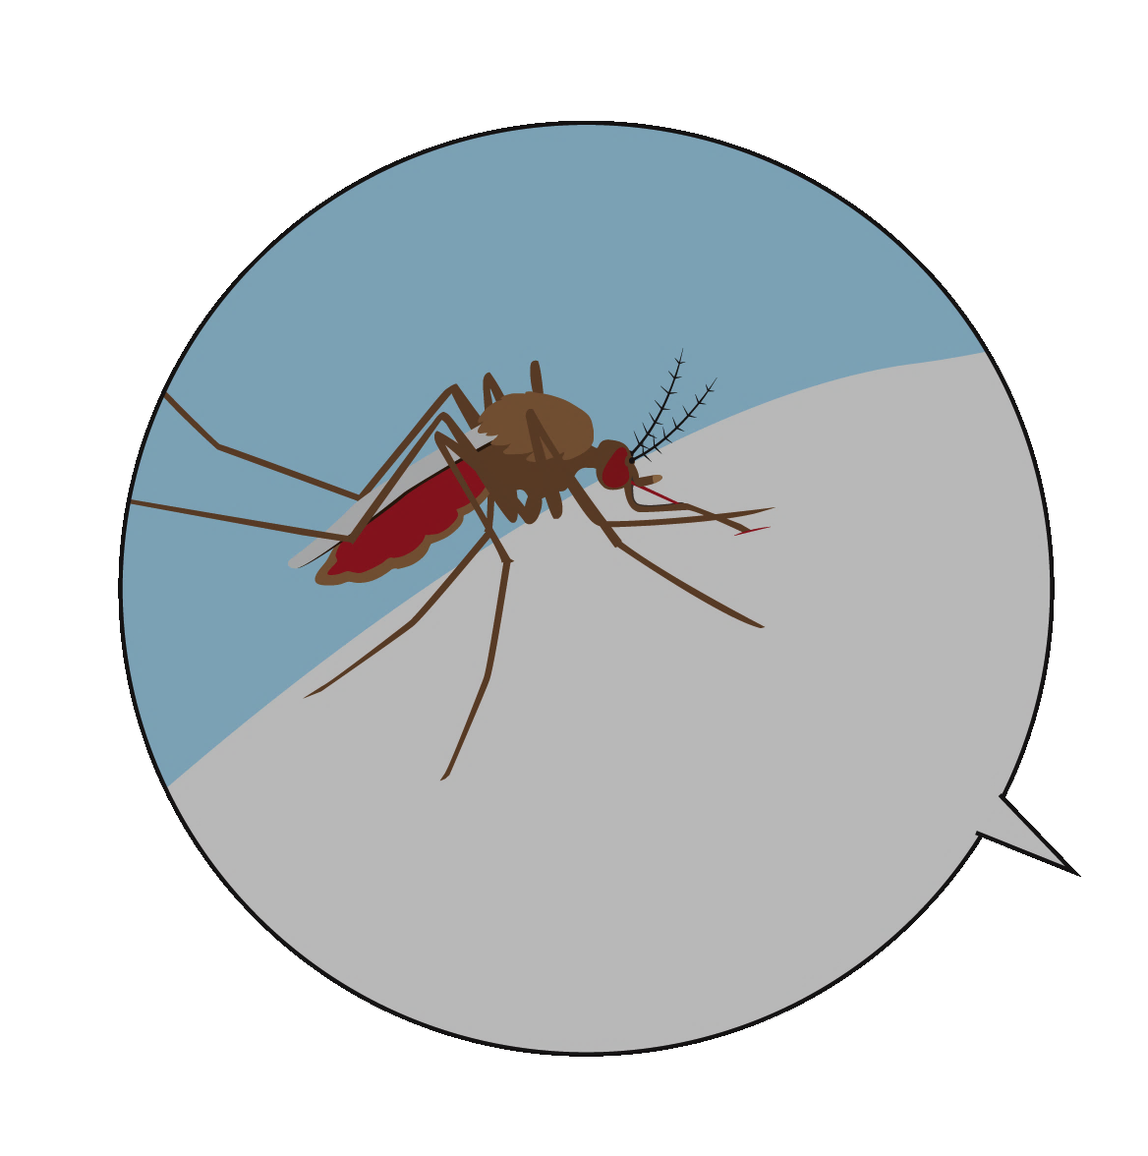
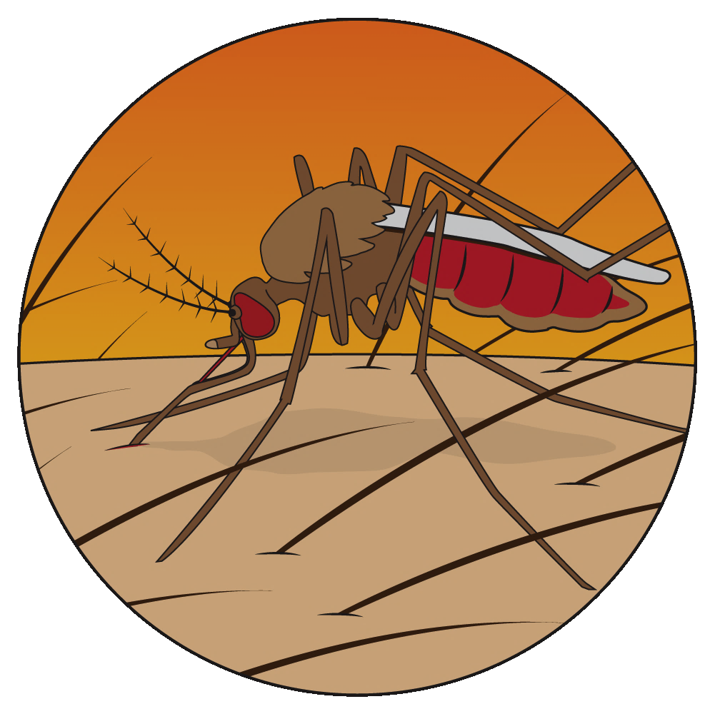
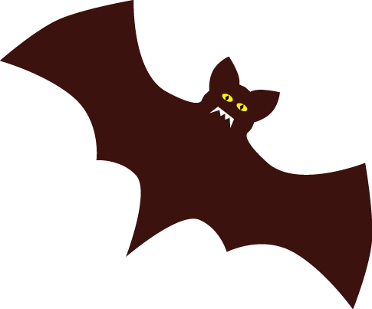
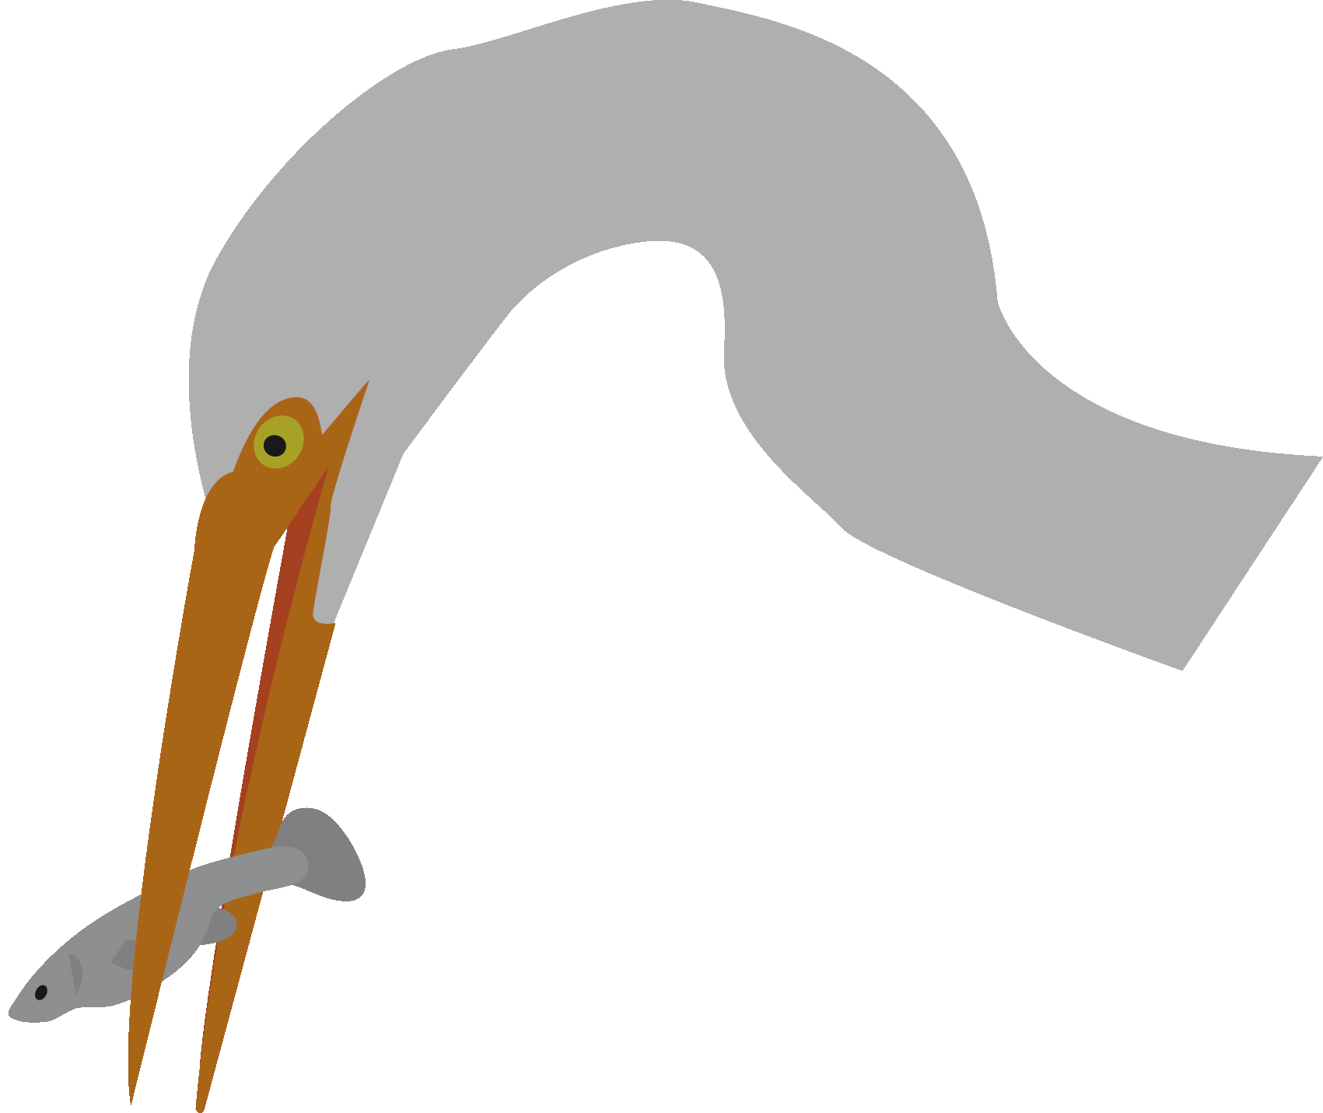
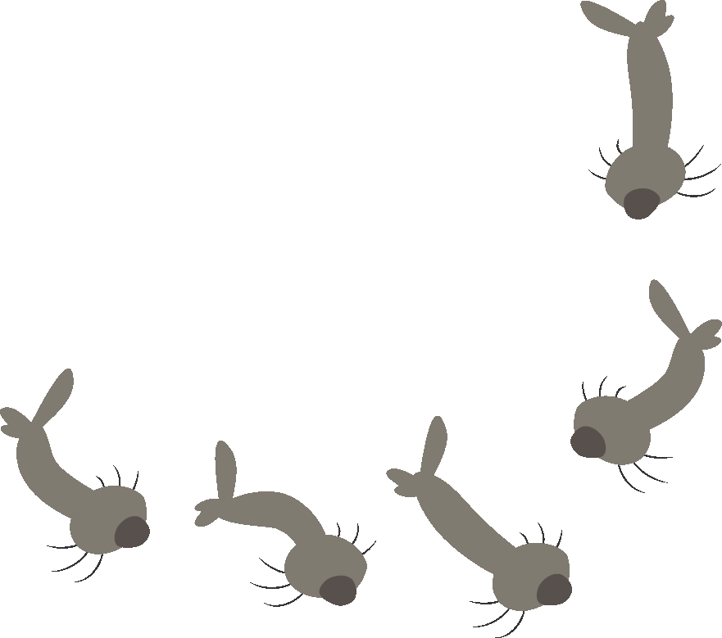
Notes:
Discuss how mosquitoes can be most active at dusk, with female mosquitoes who have mated sucking the blood of other animals, such as birds and humans. Fortunately, predators such as bats are active at night, too, and they eat tons of insects like mosquitoes!

Slide 5
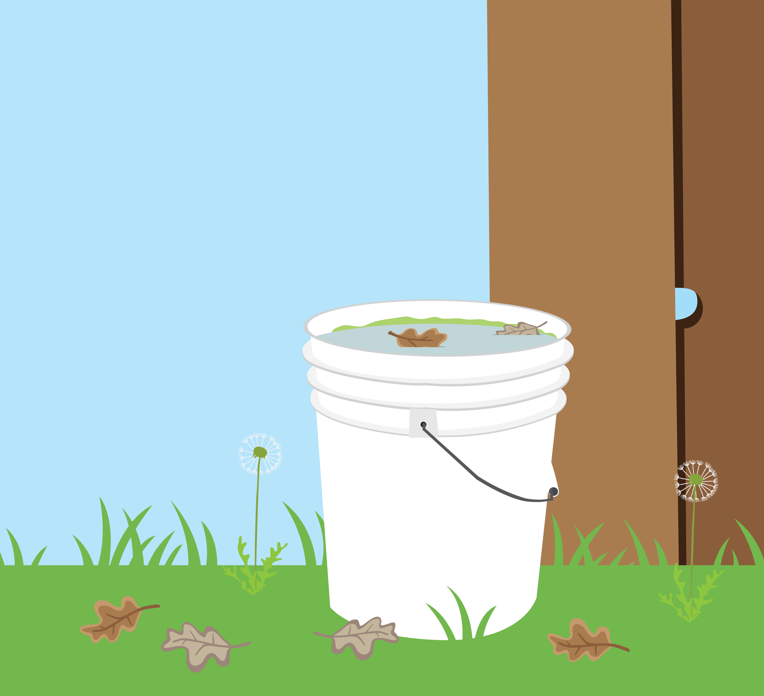
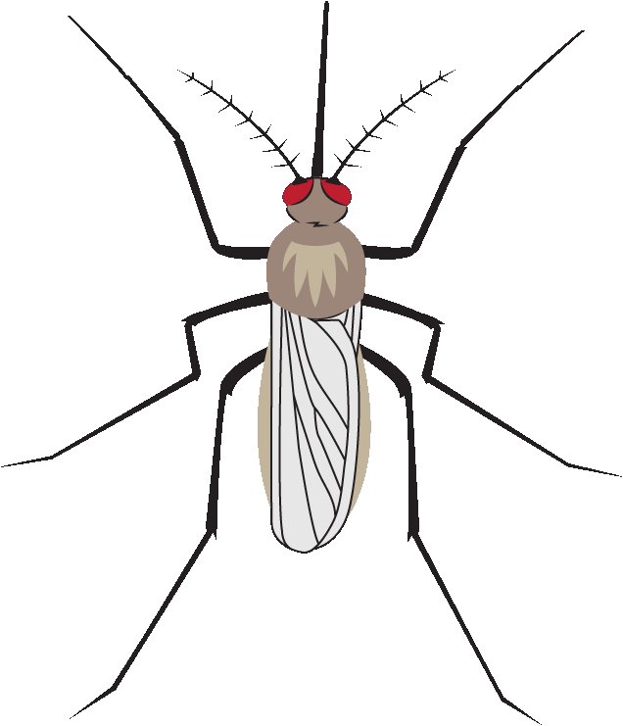
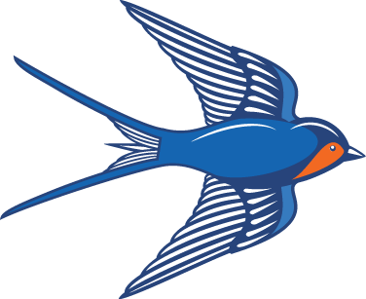
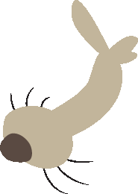
Backyard
Ecosystem
Notes:
Discuss how backyard ecosystems, including how standing water sources usually don’t contain predators like fish controlling insect populations. Many adult mosquitoes can be produced in less than a week after eggs are laid, especially in the warmer months, which is why it is so important to dump standing water. Water features like ponds should not have stagnant (standing) water, which mosquitoes need to develop. Fortunately, other predators like swallows can eat adult mosquitoes, too, and Clackamas County Vector Control can provide mosquito fish for human-made backyard ponds.

Slide 6
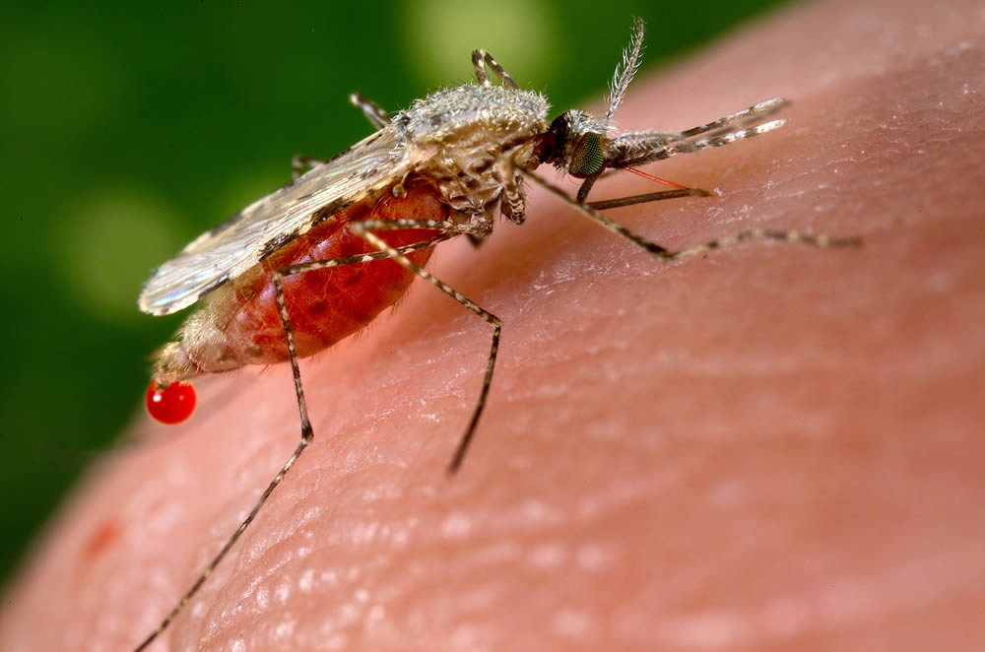
Blood-feeding
Blood
Saliva +
pathogens (virus)
Notes:
Explain how mosquitoes can transmit diseases when feeding on blood. Saliva from the mosquito goes into the host (the organism being fed on), carrying the pathogens such as West Nile virus.
These visuals can help show the process of infection:
Video: “How Mosquitoes Transmit Virus to Humans”: https://www.youtube.com/watch?v=AdOG7tij3lA
Infographics: https://www.washingtonpost.com/apps/g/page/national/how-a-bloodsucker-transmits-the-zika-virus/1964/
Image from https://pixnio.com/fauna-animals/insects-and-bugs/mosquito/an-anopheles-stephensi-mosquito-is-obtaining-a-blood-meal-from-a-human-host-through-its-pointed-proboscis

Slide 7
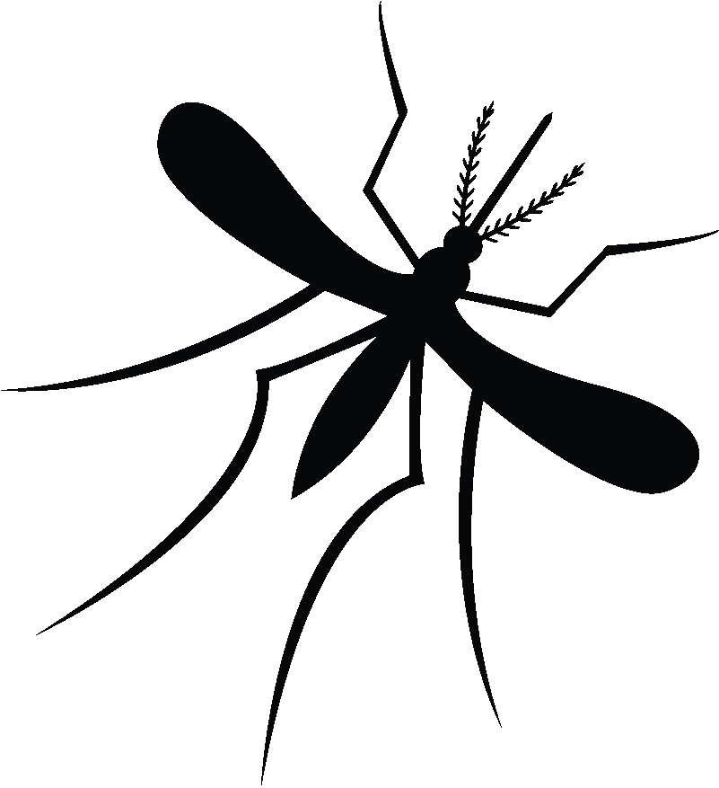
West Nile Virus, etc.
(Pathogen)
Vector
Notes:
West Nile virus is one pathogen which can make people very sick. A mosquito with the virus can infect a host such as a bird, then another mosquito can transmit the virus from the bird to a human. Mosquitoes are considered disease vectors because they can easily spread diseases from one host to another. Many birds and people have died because a mosquito infected them with West Nile virus, malaria, Zika virus and other diseases. Mosquitoes are the deadliest animal in the world to humans.
For advanced students: The birds in this case can be called reservoir hosts or amplifier hosts, because the disease can multiply in them quickly. They help the pathogen to spread to other mosquitoes, who can spread it to incidental hosts like humans and horses.
Learn more about West Nile Virus and its transmission from the Mayo Clinic: https://www.mayoclinic.org/diseases-conditions/west-nile-virus/symptoms-causes/syc-20350320

Slide 8
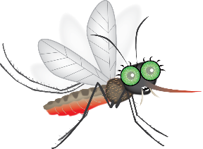
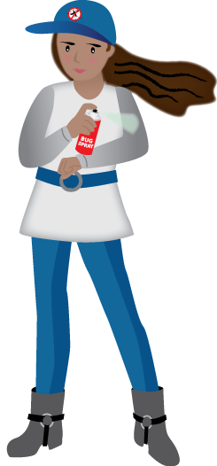
Staying Safe from Mosquitula!
Head protection
Long sleeve shirt and pants
Clothing covered in mosquito repellent
Covered feet & ankles
Notes:
Discuss these strategies to stay safe and other student ideas, such as:
Dumping standing water
Being especially careful at dusk and dawn
Using an electric fan if sitting outside in evening

Slide 9
Larva Experiment with Predators
Notes:
Discuss the experiment explained in the lesson plan.

